Slide 1

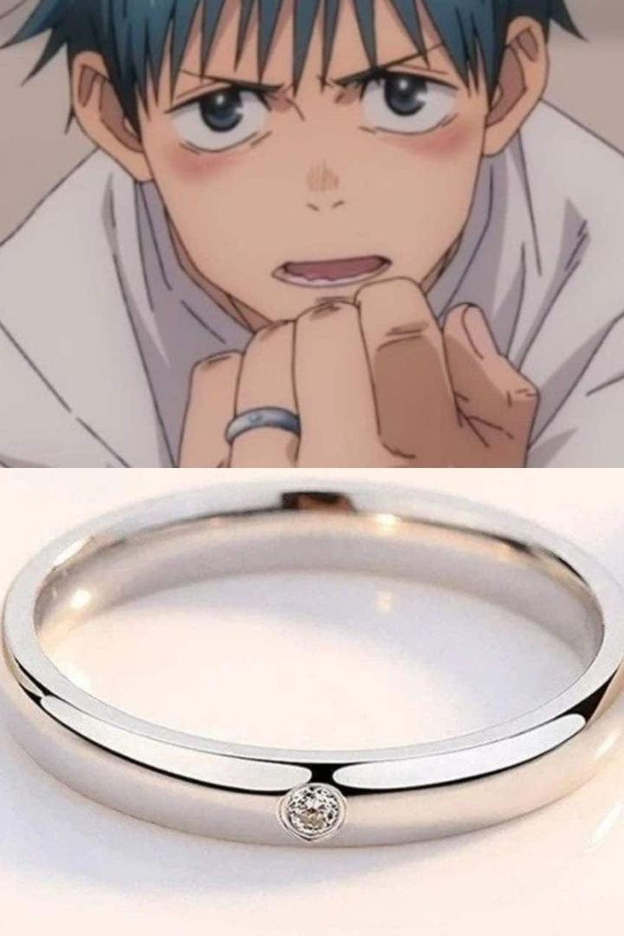
Introduction to Spinfinity
Spinfinity is a revolutionary ring designed specifically with manga readers in mind, offering a unique way to scroll through content.

Slide 2
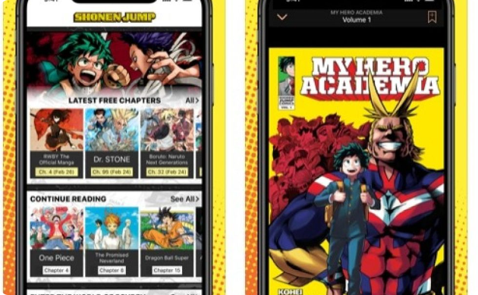

Purpose of Spinfinity: A Ring for Manga Readers
Hands-Free Scrolling
Enhanced Reading Experience
Scroll through manga pages conveniently with just a flick of the finger.
Immerse yourself in the world of manga without interruptions for a truly captivating experience.

Slide 3
Features of Spinfinity
Ergonomic Design
Precision Scrolling
Compatibility
The ring is designed for maximum comfort during extended use.
Get a seamless and precise scrolling experience with intuitive controls.
Works seamlessly with various platforms, including YouTube shorts.

Slide 4

Compatibility with YouTube Shorts
1
Seamless Integration
2
Enhanced Viewing
Scroll through engaging YouTube shorts effortlessly.
Enjoy an improved experience for watching short-form video content.

Slide 5
Benefits of Using Spinfinity
Hands-Free
Efficiency
Enjoy hands-free scrolling for uninterrupted reading.
Increase efficiency with a more fluid scrolling experience.

Slide 6
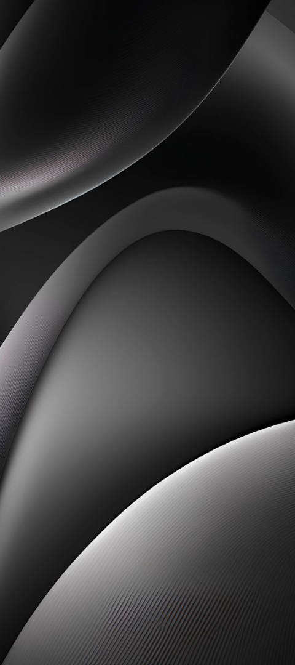
Enhancing the Manga Reading Experience
Immersive Experience
Convenience
Engage fully with the manga content, making the reading experience more immersive.
Read manga on-the-go without the need to hold a device.
Long-Term Comfort
Experience reduced fatigue during extended reading sessions.

Slide 7



Conclusion and Next Steps
Ready to Revolutionize Manga Reading?
Experience the future of manga consumption with Spinfinity.
Stay Tuned for Updates
Keep an eye out for news on the release of Spinfinity.

